Slide 1

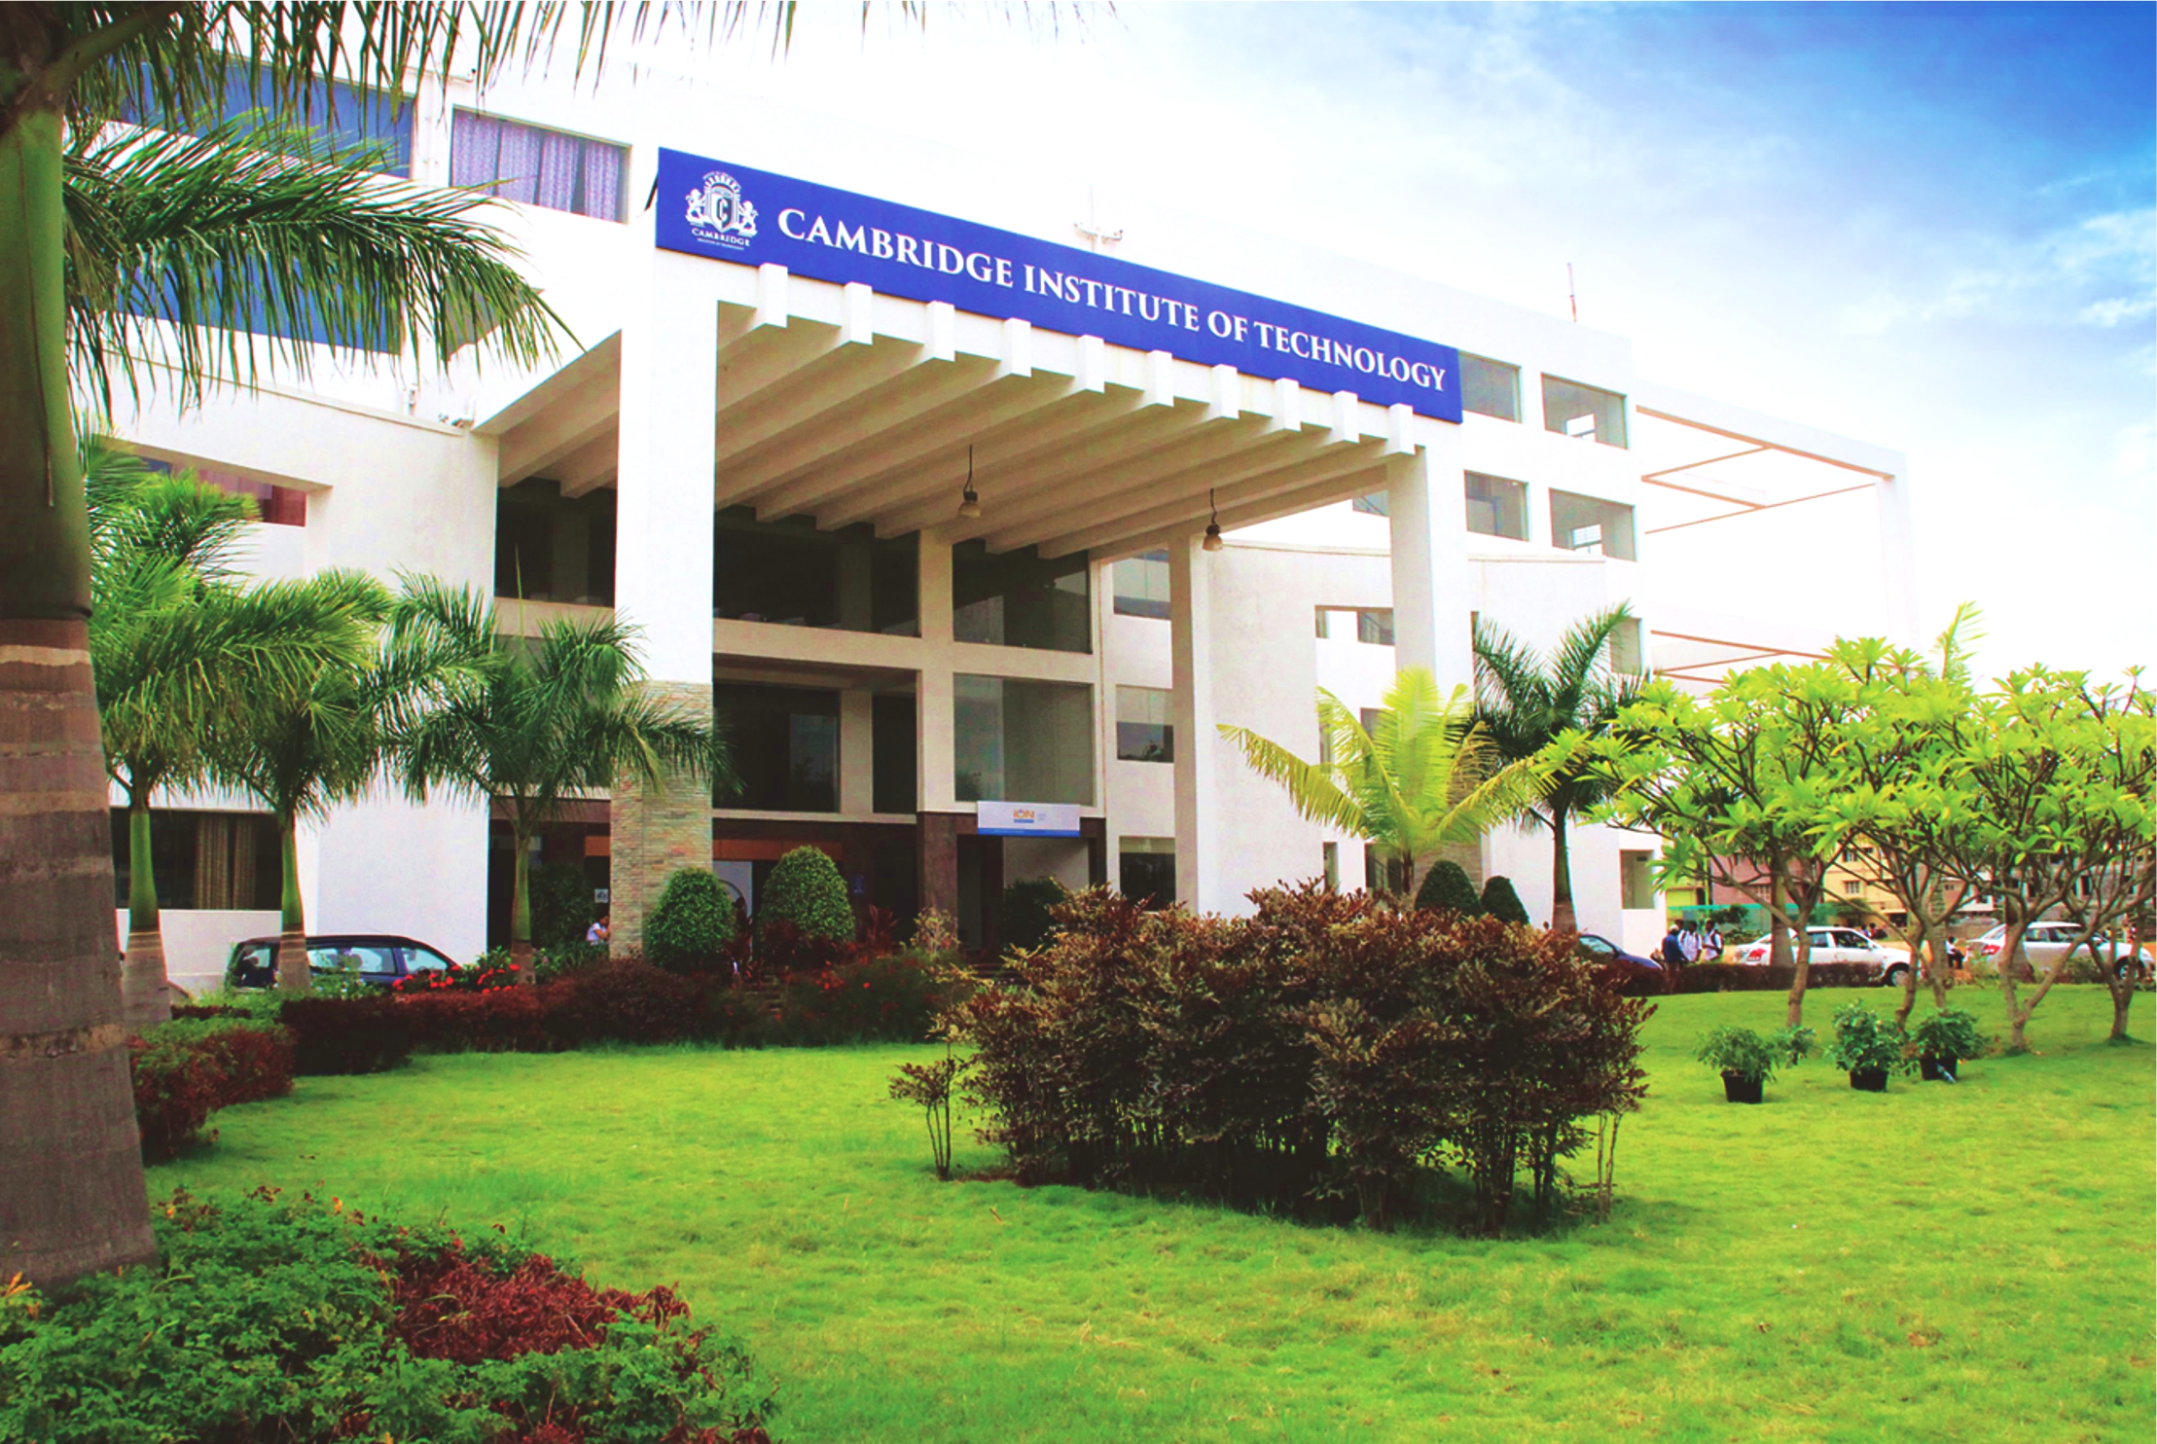
www.cambridge.edu.in
Project Work Phase – I
Subject Code:21AIMP67
Project Name:
“Story Generator”
Presented By :
MYTHRI D S 1CD21AI032
T R SHASHWITHA 1CD20AI063
Department of Artificial Intelligence and Machine Learning

Slide 2
Introduction
The art of storytelling has been a cornerstone of human expression and communication since the dawn of time. From ancient myths to modern novels, stories have captivated audiences, conveyed emotions, and preserved cultural heritage. However, the creative process of writing can be time-consuming, labor-intensive, and often limited by the author's experience and imagination.
The AI Story Generator project revolutionizes the world of storytelling by harnessing the power of artificial intelligence to generate high-quality, engaging stories autonomously. This innovative system combines cutting-edge technologies in natural language processing (NLP), machine learning (ML), and narrative theory to produce unique and captivating stories.
Department of Artificial Intelligence and Machine Learning www.Cambridge.edu.in

Slide 3
Literature Survey
SL NO | PAPER TITLE | JOURNAL NAME | DESCRIPTION | PROS | CONS
1 | A Hierarchical Neural Autoencoder for Paragraphs and Documents | Association for Computational Linguistics (ACL), 2015 | This paper introduces a hierarchical neural autoencoder designed for generating coherent paragraphs and documents, using a two-level LSTM to model both sentence and document-level representations. | Captures long-range dependencies Generates coherent and contextually relevant text | Computationally intensive breaks Requires large amounts of training data
2 | Plan-and-Write: Towards Better Automatic Storytelling | Association for the Advancement of Artificial Intelligence (AAAI), 2019 | This paper presents the Plan-and-Write model, which first generates a high-level plan (sequence of actions) and then uses this plan to guide the generation of a detailed story, improving coherence and logical flow. | Improved coherence and logical flow of generated stories Flexibility in story generation | Complexity in model training Dependence on quality of the high-level plan
Department of Artificial Intelligence and Machine Learning www.Cambridge.edu.in

Slide 4
3 | Story Generation with Deep Reinforcement Learning | Neural Information Processing Systems (NeurIPS), 2020 | This paper explores using deep reinforcement learning to generate stories, focusing on enhancing creativity and coherence by learning from human feedback. | High creativity and diversity in story generation Learns from human feedback Can adapt to different genres and styles Improves over time with more feedback | Requires significant computational resources Human feedback can be inconsistent Model training is complex
4 | StoryGAN: A Sequential Conditional GAN for Story Visualization | IEEE Conference on Computer Vision and Pattern Recognition (CVPR), 2019 | This paper introduces StoryGAN, a generative adversarial network designed to generate visual storyboards from textual narratives, focusing on preserving the consistency and logical progression of the story in the generated images. | Generates coherent visual storyboards Maintains consistency across generated images | Limited to generating visual content High computational cost
Department of Artificial Intelligence and Machine Learning www.Cambridge.edu.in

Slide 5
Problem Statement
"In the digital age, the demand for creative content is ever-increasing. From authors and screenwriters to game developers and marketers, the need for engaging narratives spans across multiple industries. However, crafting compelling stories can be time-consuming and challenging. This project introduces an AI-Driven Story Generator designed to assist in the creation of narratives by leveraging advanced machine learning techniques.”
Department of Artificial Intelligence and Machine Learning www.Cambridge.edu.in

Slide 6
Abstract
The AI-Driven Story Generator project addresses the challenge of creating engaging narratives efficiently. By combining a user-friendly HTML/CSS frontend with a Python and Flask backend, this system enables users to input prompts and receive high-quality, coherent stories generated by the GPT-2 model. It aims to streamline the creative writing process, providing instant, customizable content for various applications such as writing, education, and marketing. This tool enhances productivity and creativity by automating narrative generation, demonstrating the potential of artificial intelligence to support and augment human creativity.
Department of Artificial Intelligence and Machine Learning www.Cambridge.edu.in

Slide 7
Objectives
Develop a User-Friendly Interface: Design and implement an intuitive web-based frontend using HTML and CSS to facilitate easy input of story prompts and display generated narratives.
Create an Efficient Backend System: Build a robust backend using Python and Flask to process user inputs, manage interactions with the AI model, and handle story generation requests.
Integrate Advanced NLP Model: Utilize the GPT-2 model to generate coherent, high-quality stories based on user-defined prompts, ensuring the narratives are engaging and contextually relevant.
Ensure Coherence and Structure in Stories: Implement measures to ensure that the generated stories have a clear beginning, middle, and end, enhancing their overall readability and quality.
Demonstrate Practical Applications: Showcase the tool’s utility across different domains such as creative writing, education, and marketing, highlighting its potential to support and augment various content creation processes.
Department of Artificial Intelligence and Machine Learning www.Cambridge.edu.in

Slide 8
System Requirements Analysis
Hardware Requirements:
Processor: Modern multi-core CPU (e.g., Intel i7, AMD Ryzen 7); optional high-performance GPU (e.g., NVIDIA RTX 3080).
Memory: At least 16 GB RAM (32 GB recommended).
Storage: 256 GB SSD for OS/software, 1 TB additional storage for datasets/models.
Software Requirements:
Operating System: Windows 10/11, macOS, or modern Linux (e.g., Ubuntu 20.04+).
Programming Language: Python 3.7+.
Development Environment: IDE or text editor (PyCharm, VS Code, Jupyter Notebook).
Department of Artificial Intelligence and Machine Learning www.Cambridge.edu.in

Slide 9
System Architecture
User Interface (HTML/CSS)
Frontend Logic (JavaScript)
Backend Server (Python, Flask)
Machine Learning Model
(GPT-2)
Generation of Story
Output
Generated Story
Department of Artificial Intelligence and Machine Learning www.Cambridge.edu.in

Slide 10
Methodology
Input Data: Text prompts are provided as primary inputs to the system.
Preprocessing: The input prompts are preprocessed using data augmentation and normalization techniques to ensure compatibility and enhance the performance of the model.
Model Initialization: The GPT-2 model is loaded using the transformers library to facilitate text generation.
API Endpoint: Create a /generate endpoint in the Flask application to handle POST requests and receive text prompts.
Text Generation: The preprocessed prompts are fed into the GPT-2 model to generate coherent and contextually relevant stories.
Post-processing: The generated text is refined and formatted to ensure clarity and readability.
Outputs: The system outputs the generated stories in JSON format, which are then displayed to the user through the web interface.
Department of Artificial Intelligence and Machine Learning www.Cambridge.edu.in

Slide 11
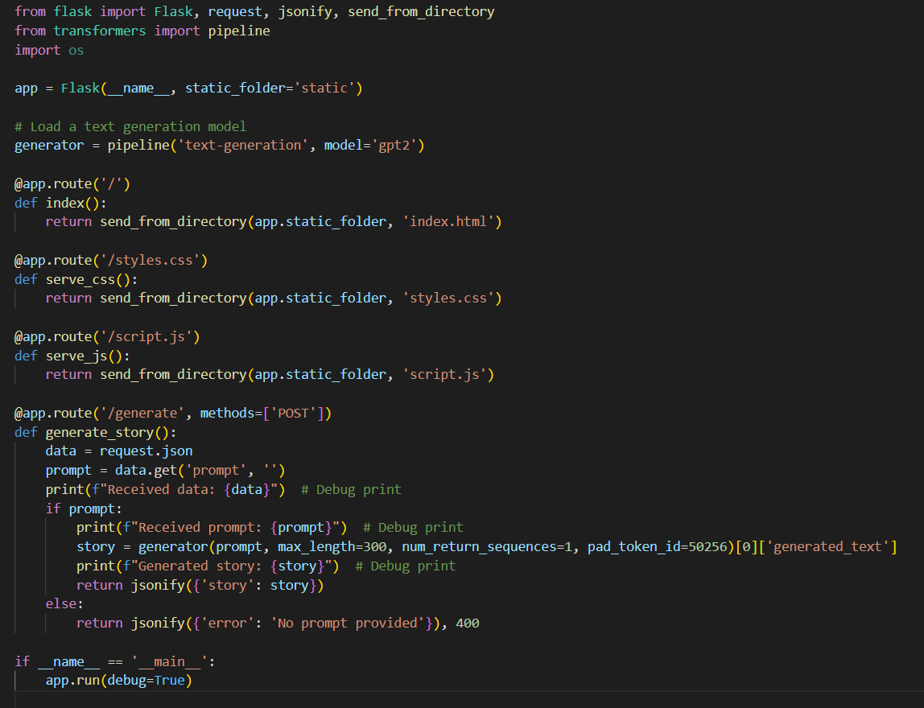
Implementation
Python - app.py
Department of Artificial Intelligence and Machine Learning www.Cambridge.edu.in

Slide 12
Implementation
Imported Libraries
Flask: Used to create the Flask web application.
request: Handles incoming HTTP requests.
jsonify: Converts Python dictionaries to JSON responses.
send_from_directory: Serves static files from a specified directory.
pipeline: Used to load and use pre-trained NLP models.
from flask import Flask, request, jsonify, send_from_directory
from transformers import pipeline
Department of Artificial Intelligence and Machine Learning www.Cambridge.edu.in

Slide 13
Implementation
app = Flask(__name__, static_folder='static')
# Load a text generation model
generator = pipeline('text-generation', model='gpt2')
@app.route('/')
def index():
return send_from_directory(app.static_folder, 'index.html')
@app.route('/styles.css')
def serve_css():
return send_from_directory(app.static_folder, 'styles.css')
@app.route('/script.js')
def serve_js():
return send_from_directory(app.static_folder, 'script.js')
Initializes the Flask app and specifies the static folder where static files HTML,CSS, and JS are located.
Loads the GPT-2 model for generating text based on prompts
Defines the file routes and serving html,css,java script file from the static folder
Department of Artificial Intelligence and Machine Learning www.Cambridge.edu.in

Slide 14
Implementation
@app.route('/generate', methods=['POST'])
def generate_story():
data = request.json
prompt = data.get('prompt', '')
print(f"Received data: {data}") # Debug print
if prompt:
print(f"Received prompt: {prompt}") # Debug print
story = generator(prompt, max_length=300, num_return_sequences=1, pad_token_id=50256)[0]['generated_text']
print(f"Generated story: {story}") # Debug print
return jsonify({'story': story})
else:
return jsonify({'error': 'No prompt provided'}), 400
Defines the route for the POST request to generate a story.
Retrieves JSON data from the request.
Extracts the prompt from the request data.
Prints received data for debugging.
Checks if a prompt was provided
Uses the GPT-2 model to generate a story based on the prompt.
Prints the generated story for debugging.
Returns the generated story as a JSON response.
If prompt is not provided
Returns an error message with a 400 status code.
Department of Artificial Intelligence and Machine Learning www.Cambridge.edu.in

Slide 15
Implementation
if __name__ == '__main__':
app.run(debug=True)
Runs the Flask application with debug mode enabled, which provides detailed error messages and auto-reloads the server when code changes.
Department of Artificial Intelligence and Machine Learning www.Cambridge.edu.in

Slide 16
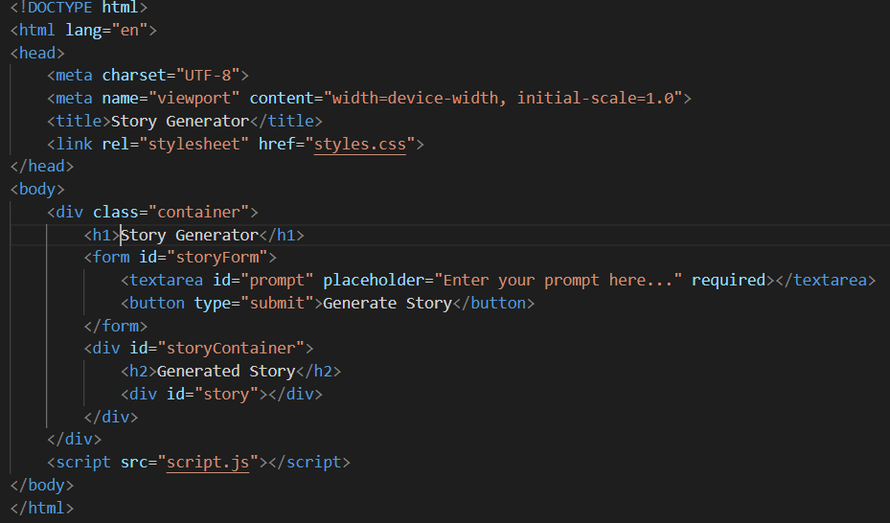
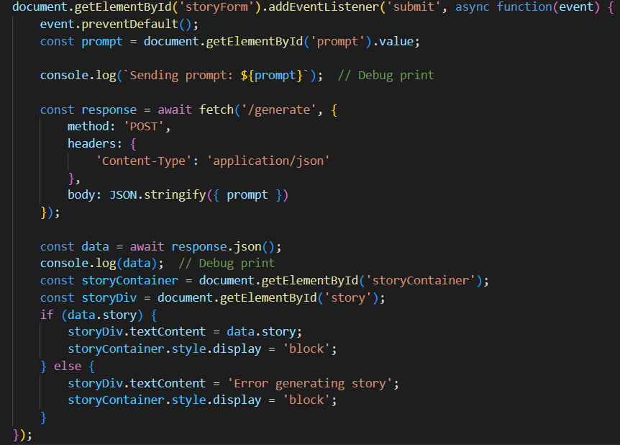
Implementation
HTML- index.html Java Script – script.js
Department of Artificial Intelligence and Machine Learning www.Cambridge.edu.in

Slide 17
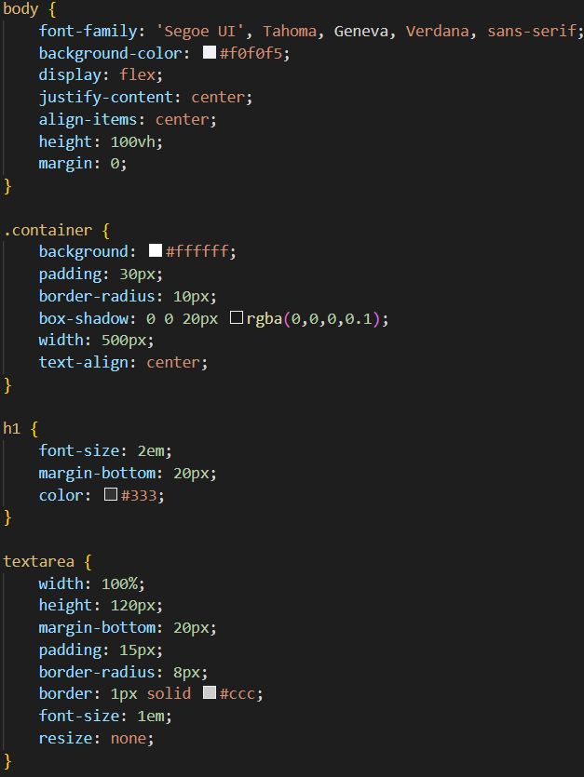
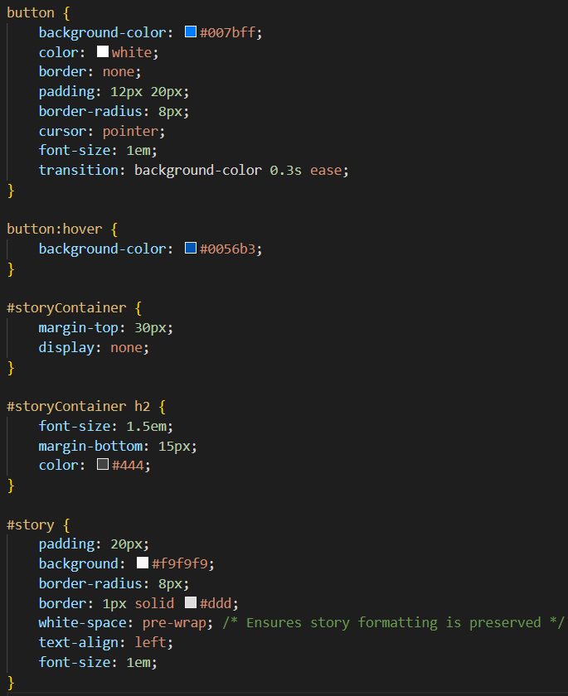
Implementation
CSS – styles.css
Department of Artificial Intelligence and Machine Learning www.Cambridge.edu.in

Slide 18
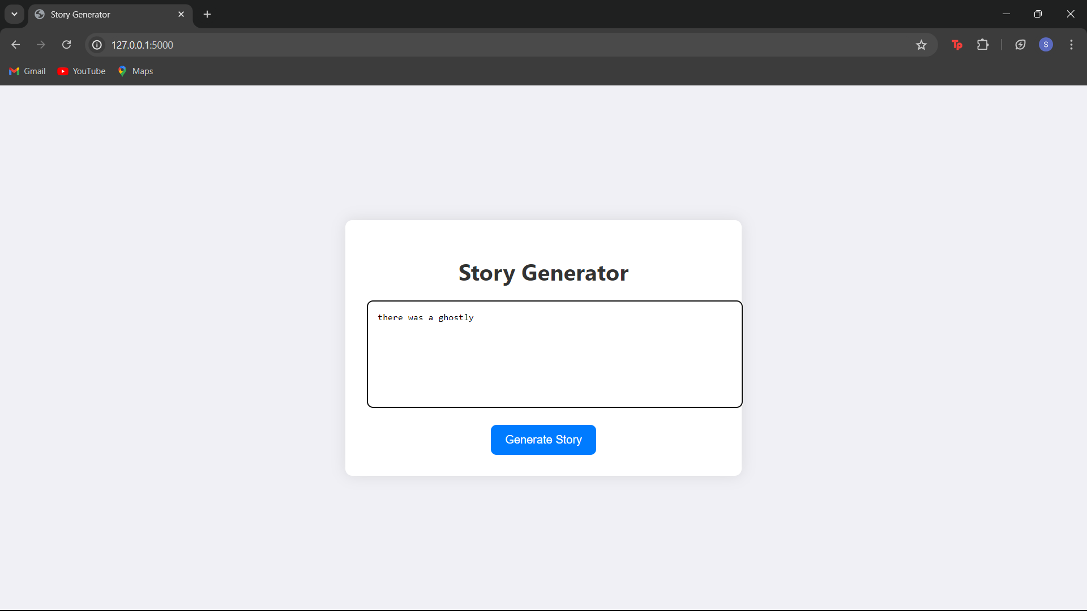
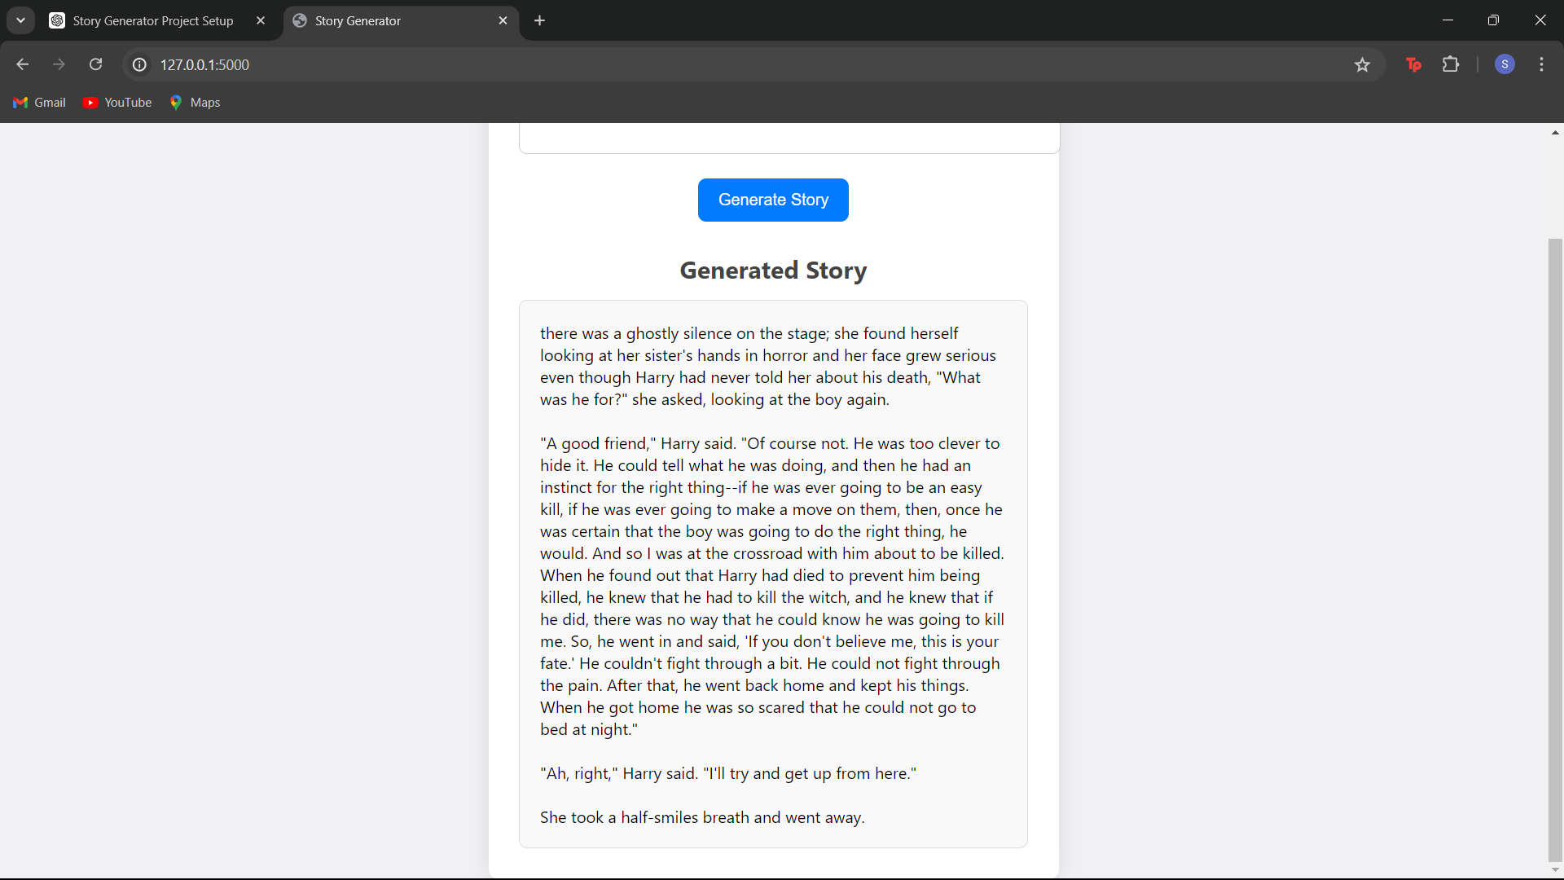
Results :
Department of Artificial Intelligence and Machine Learning www.Cambridge.edu.in

Slide 19
Conclusion
The AI-Driven Story Generator project effectively showcases the power of advanced natural language processing through the integration of GPT-2 for generating engaging stories. By combining a Flask backend with a user-friendly frontend, the application provides a seamless experience where users can input prompts and receive coherent, contextually rich stories. The system demonstrates successful interaction between the frontend and backend, serving static files efficiently and generating creative content in response to user input. Key achievements include the dynamic generation of diverse narratives and an intuitive interface that enhances user engagement. This project not only illustrates the potential of generative AI in creative fields but also lays the groundwork for future developments, such as incorporating more sophisticated models, improving user interface design, and exploring additional features. Overall, it represents a significant step forward in leveraging AI for interactive storytelling applications.
Department of Artificial Intelligence and Machine Learning www.Cambridge.edu.in

Slide 20
Future Work
Future improvements and extensions of the project could include:
Model Improvement : Advanced models to generate the story
User experience enhancement : Add interactive elements such as story branching, where users can influence the direction of the narrative. Implement user profiles and preferences to generate stories that align with individual tastes and previous interactions.
Extended capabalities : Allow users to provide inputs beyond text, such as images or audio, to generate multimedia-enhanced stories.
Multilingual Support : Introduce support for multiple languages to reach a global audience.
Department of Artificial Intelligence and Machine Learning www.Cambridge.edu.in

Slide 21
References
https://cdn.openai.com/better-language-models/language_models_are_unsupervised_multitask_learners.pdf GPT-2 model's architecture and capabilities.
https://github.com/huggingface/transformers - Pre-trained models, including GPT-2, for various NLP tasks.
https://www.geeksforgeeks.org/how-to-build-a-random-story-generator-using-python - How to build a story generator
ChatGPT
https://flask.palletsprojects.com - The official documentation for Flask, a web framework for Python, detailing setup, usage, and best practices.
Department of Artificial Intelligence and Machine Learning www.Cambridge.edu.in

Slide 22
THANK YOU
Department of Artificial Intelligence and Machine Learning www.Cambridge.edu.in

